Slide 1
Better Share Target In The Lab
Li Xiaozhan
2018.5.18

Slide 2
Current Situation
Some target boards are in the lab and others are on the desk.
Some target boards have only one interface.
Some target boards are needed to be shared with other teams to run network performance test.
We do not have solutions to divide private and public traffic

Slide 3
Layer3 Switch Solution
Configure port 1-4 for Layer4 server
Configure port 5-12 for different targets
Configure port 13-24 for public network

Slide 4
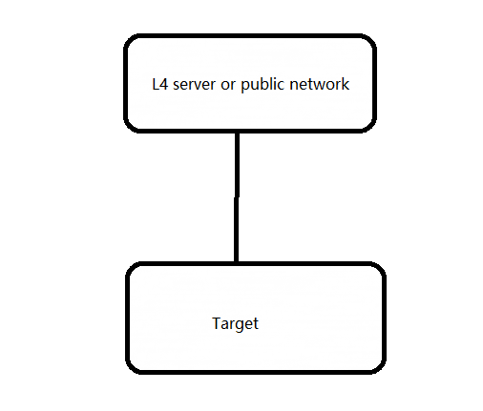
Old Topology

Slide 5
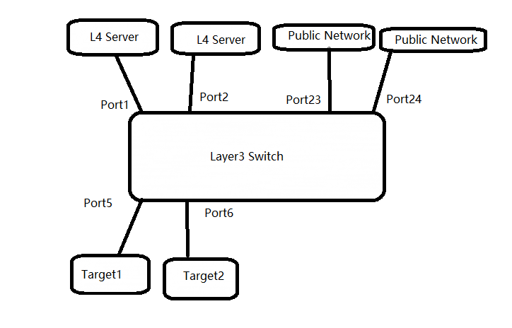
New Topology

Slide 6
Outcomes
For performance test, the traffic is going toward L4 server.
For nightly test, the traffic is going toward public network.
Configure observation port to check traffic data

Slide 7
Configuration
[Quidway] interface gigabitethernet 0/0/5 --------------this belongs to vlan 10 and 20
[Quidway-GigabitEthernet0/0/5] port link-type hybrid
[Quidway-GigabitEthernet0/0/5] port hybrid untagged vlan 10 20 you can add more vlan
[Quidway-GigabitEthernet0/0/5] ip-subnet-vlan enable
[Quidway-GigabitEthernet0/0/5] quit

Slide 8
Configuration
[Quidway]interface GigabitEthernet 0/0/5
[Quidway-GigabitEthernet0/0/5]dis this
#
interface GigabitEthernet0/0/5
port link-type hybrid
port hybrid untagged vlan 10 20
ip-subnet-vlan enable
#
return

Slide 9
Configuration
[Quidway]vlan 10
[Quidway-vlan10]ip-subnet-vlan 1 ip 192.168.2.4 24 priority 2---this is used 15 lab
you can try to add this one if there is another L4 interface:
[Quidway-vlan10]ip-subnet-vlan 2 ip 11.11.11.2 24 priority 5----this is for system nightly
[Quidway-vlan10]quit

Slide 10
Configuration
[Quidway]vlan 20
[Quidway-vlan20]
[Quidway-vlan20]ip-subnet-vlan 1 ip 128.224.166.4 24 priority 3----this is for the target on the 15th floor
[Quidway-vlan20]ip-subnet-vlan 2 ip 128.224.156.2 24 priority 4---you can add this one if this is on the 3rd floor
[Quidway-vlan20]q
[Quidway]

Slide 11
Configuration
[Quidway]interface GigabitEthernet 0/0/1
[Quidway-GigabitEthernet0/0/1]port link-type access
[Quidway-GigabitEthernet0/0/1]port default vlan 10
[Quidway-GigabitEthernet0/0/1]q
[Quidway]interface GigabitEthernet 0/0/24
[Quidway-GigabitEthernet0/0/24]port link-type access
[Quidway-GigabitEthernet0/0/24]port default vlan 20
[Quidway-GigabitEthernet0/0/24]q

Slide 12
Configuration of mirror port
This is an example to observe port 24
[Quidway]observe-port 1 interface GigabitEthernet 0/0/2 (this port is connected to L4 server)
[Quidway]interface GigabitEthernet 0/0/24
port-mirroring to observe-port 1 both
Clear data record on interface:reset counters interface GigabitEthernet 0/0/24

